Slide 1



Operating System
Motherboard

Slide 2

TABLE OF CONTENTS
01
DEFINITION OF MOTHERBOARD
02
COMPONENT OF MOTHERBOARD
03
CONCLUSION

Slide 3
01
DEFINITION OF
MOTHERBOARD

Slide 4


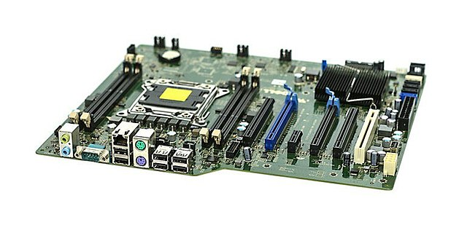
DEFINITION OF MOTHERBOARD
MOTHERBOARD
A motherboard, also known as a mainboard or system board, is the central circuit board in a computer that connects all the components together. It is a large printed circuit board (PCB) that provides the electrical and mechanical connections between various components, such as the CPU, RAM, storage devices, and expansion cards.

Slide 5
02
COMPONENT OF MOTHERBOARD

Slide 6
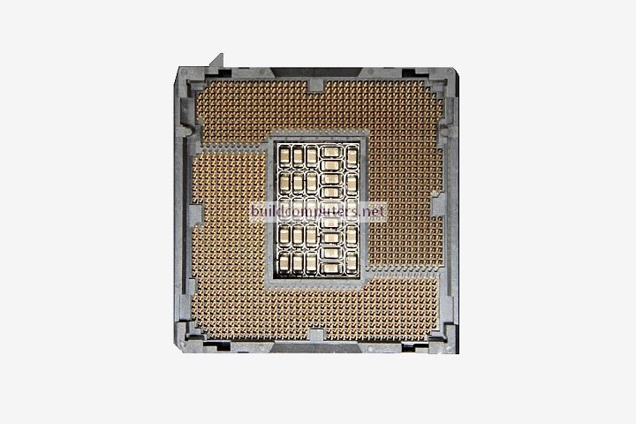
CPU Socket
This is where the central processing unit (CPU) is inserted. The CPU is the brain of the computer and performs all the necessary calculations and computations.

Slide 7
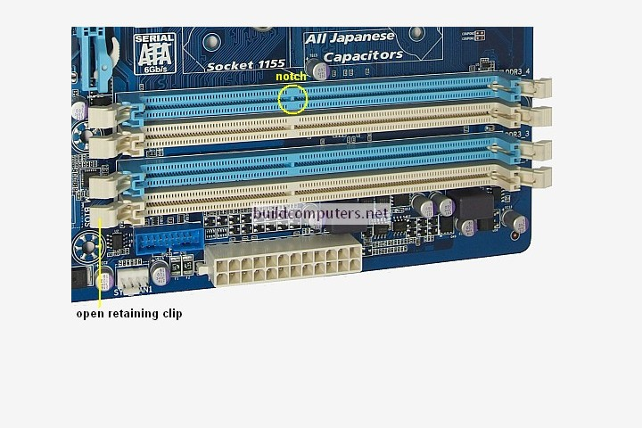
RAM Slots
Random Access Memory (RAM) is used to temporarily store data that the CPU needs to access quickly. The RAM slots are where you insert the RAM modules.

Slide 8
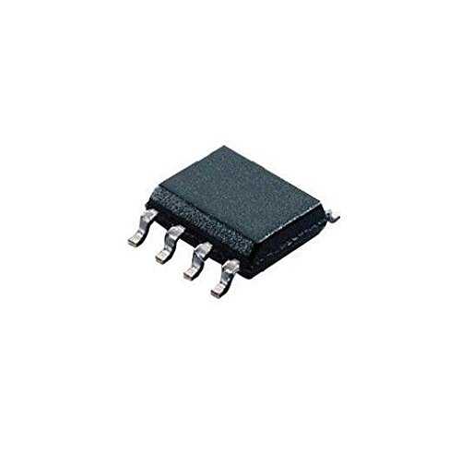
BIOS Chip
This chip stores the Basic Input/Output System (BIOS), which is responsible for initializing the hardware and software during the boot process.

Slide 9

CMOS Battery
This battery powers the CMOS memory, which stores the BIOS settings and the system clock.

Slide 10
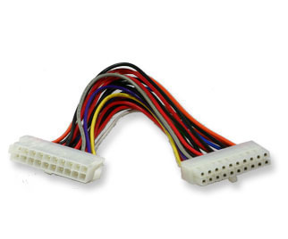
Power Connectors
The power connectors are where you attach the power supply cables. The power supply provides power to all the components on the motherboard and in the computer.

Slide 11
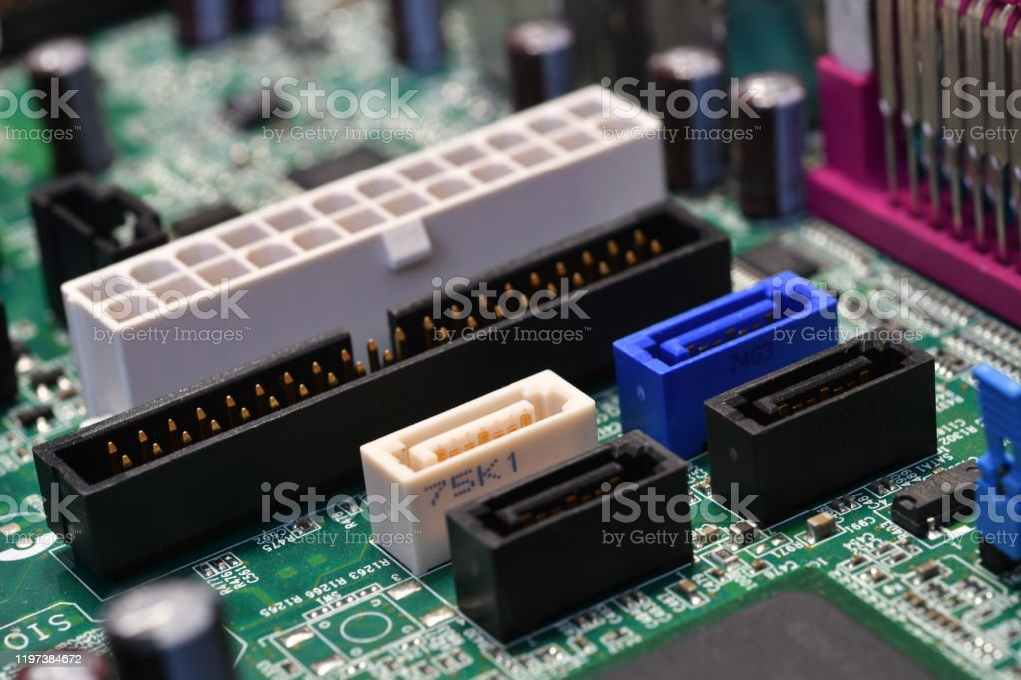
SATA Ports
These ports are used to connect storage devices, such as hard drives and solid-state drives (SSDs), to the motherboard.

Slide 12
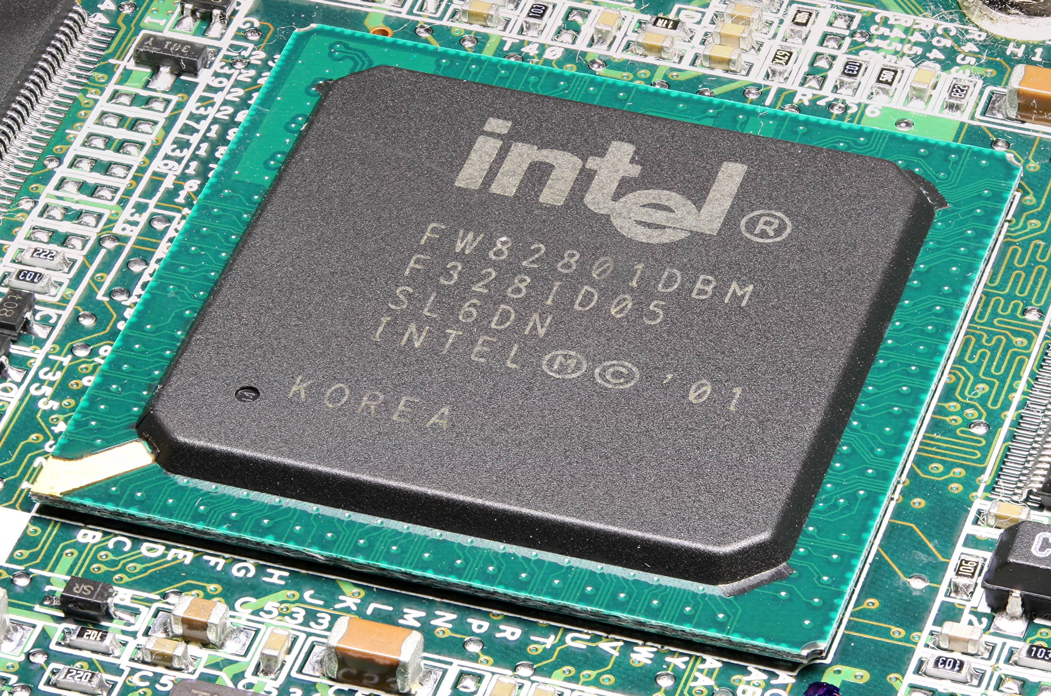
Chipset
The chipset manages the communication between the CPU, RAM, expansion cards, and other components on the motherboard.

Slide 13
03
CONCLUSION

Slide 14
Choosing the right motherboard is crucial for building a stable and reliable computer system, and it depends on factors such as the intended use, type of CPU and RAM, and number and types of expansion cards needed. Overall, the motherboard plays a critical role in the overall functionality and performance of a computer system.
CONCLUSION
In conclusion, a motherboard is a central circuit board that connects all the components of a computer system. It serves as a backbone and enables communication between various devices such as the CPU, RAM, storage devices, and expansion cards. The motherboard contains important components such as the chipset, BIOS, and power regulators that ensure proper functionality of the system.

Slide 15

MACOS
MacOS is an operating system developed by Apple Inc. It is used exclusively on Apple computers and is known for its sleek and user-friendly interface. MacOS is often preferred by people who work in creative industries, such as design and music production.

Slide 16
LINUX
Linux is a free and open-source operating system that is widely used on servers, supercomputers, and other types of computing devices. It is highly customizable and can be tailored to meet specific needs. There are many different versions of Linux, known as distributions, each with its own set of features and tools.
is an operating system developed by Apple Inc. It is used exclusively on Apple computers and is known for its sleek and user-friendly interface. MacOS is often preferred by people who work in creative industries, such as design and music production.

Slide 17
UNIX
Unix is an older operating system that is still used today, particularly in enterprise computing environments. It is known for its stability, security, and reliability. Like Linux, Unix is highly customizable and can be tailored to meet specific needs.
is an operating system developed by Apple Inc. It is used exclusively on Apple computers and is known for its sleek and user-friendly interface. MacOS is often preferred by people who work in creative industries, such as design and music production.

Slide 18
CHROME OS
Chrome OS is a lightweight operating system developed by Google. It is designed to run on low-cost hardware, such as Chromebooks, and is highly optimized for web-based applications. It is simple to use and is ideal for people who primarily use their computers for browsing the web, using social media, and basic productivity tasks.

Slide 19
MOBILE OPERATING SYSTEMS
Mobile operating systems, such as Android and iOS, are used on smartphones and tablets. They are highly optimized for touch-based interfaces and support a wide range of apps and games. They are designed to be highly portable and energy-efficient, making them ideal for use on mobile devices.

Slide 20
Operating System
End

Slide 21

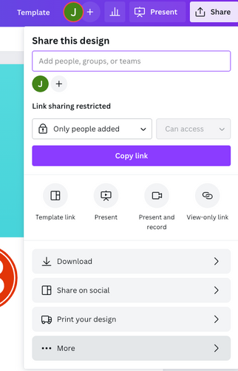
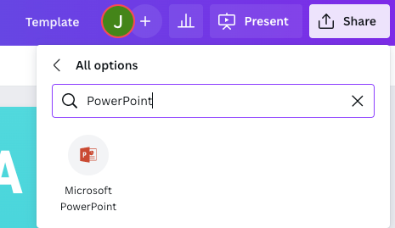
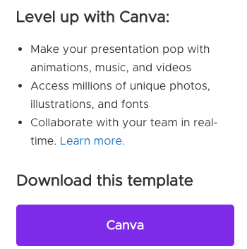
TYPES OF OPERATING SYSTEMS
1
2
3
Click on the "Canva" button next to this presentation. Start editing your presentation. You may need to sign in to your Canva account.
Click on the "Share" button on the top right corner in Canva and click on "More" at the bottom of the menu.
Enter "PowerPoint" in the search bar and click on the PowerPoint icon to download.

Slide 22
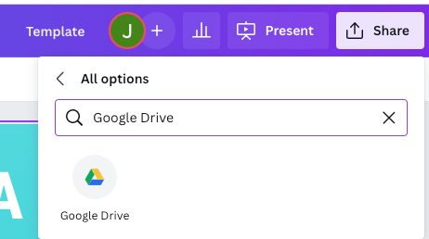
DOWNLOAD THIS PRESENTATION AS
A GOOGLE SLIDE TEMPLATE IN 3 STEPS
1
2
3
Click on the "Canva" button next to this presentation. Start editing your presentation. You may need to sign in to your Canva account.
Click on the "Share" button on the top right corner in Canva and click on "More" at the bottom of the menu.
Enter "Google Drive" in the search bar and click on the Google Drive icon to add this design as a Google slide in your G Drive. It will ask you to link your Google account to Canva the first time.

Slide 23


HELLO THERE!
I'm Rain. Welcome to my education presentation.
Follow me at @reallygreatsite to learn more.

Slide 24





ADD A TEAM MEMBERS PAGE
Elaborate on what you want to discuss.
NAME
NAME
NAME
NAME
Title or Position
Title or Position
Title or Position
Title or Position

Slide 25


WRITE AN ORIGINAL STATEMENT OR INSPIRING QUOTE
— Include a credit, citation, or supporting message

Slide 26
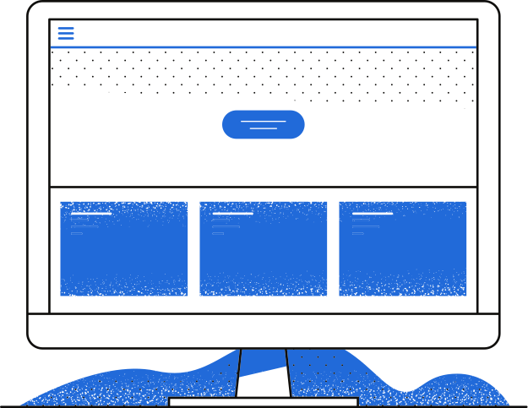
OBJECTIVES
OBJECTIVES
02
OBJECTIVES
OBJECTIVES
OBJECTIVES
OBJECTIVES
OBJECTIVES
OBJECTIVES
OBJECTIVES
OBJECTIVES
OBJECTIVES

Slide 27



STUDY OBJECTIVES
Objective 1
Objective 2
Objective 3
Briefly elaborate on what you want to discuss.
Briefly elaborate on what you want to discuss.
Briefly elaborate on what you want to discuss.

Slide 28

ADD A MAIN POINT
WRITE YOUR TOPIC OR IDEA
Elaborate on what you want to discuss.
ADD A MAIN POINT
Elaborate on what you want to discuss.
ADD A MAIN POINT
Elaborate on what you want to discuss.

Slide 29


ADD A MAIN POINT
ADD A MAIN POINT
ADD A MAIN POINT
WRITE YOUR TOPIC OR IDEA
Briefly elaborate on what you want
to discuss.

Slide 30

METHODOLOGY
METHODOLOGY
03
METHODOLOGY
METHODOLOGY
METHODOLOGY
METHODOLOGY
METHODOLOGY
METHODOLOGY
METHODOLOGY
METHODOLOGY
METHODOLOGY

Slide 31


SCHEDULE
1ST QUARTER
January
Double click to add task
February
Double click to add task
March
Double click to add task
2ND QUARTER
April
Double click to add task
May
Double click to add task
June
Double click to add task
3RD QUARTER
July
Double click to add task
August
Double click to add task
September
Double click to add task
4TH QUARTER
October
Double click to add task
November
Double click to add task
December
Double click to add task

Slide 32
Write a Heading Here

Slide 33

SUMMARY
SUMMARY
SUMMARY
04
SUMMARY
SUMMARY
SUMMARY
SUMMARY
SUMMARY
SUMMARY
SUMMARY
SUMMARY
SUMMARY
SUMMARY
SUMMARY

Slide 34

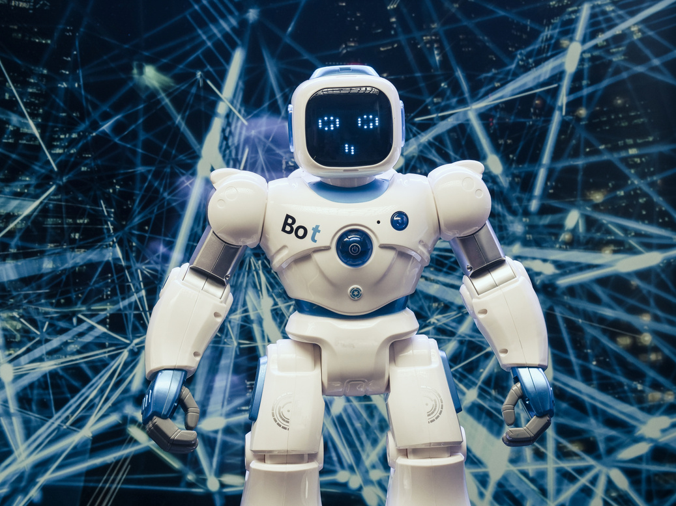


Write a caption for
the photos.

Slide 35


2 OUT OF 5
Elaborate on the featured statistic.
95%
Elaborate on the featured statistic.
12 MILLION
Elaborate on the featured statistic.

Slide 36

S
W
O
T
STRENGTHS
WEAKNESSES
OPPORTUNITES
THREATS
What are you doing well?
What sets you apart?
What are your
good qualities?
Where do you need
to improve?
Are resources adequate?
What do others do
better than you?
What are your goals?
Are demands shifting?
How can it be improved?
What are the blockers
you're facing?
What are factors outside
of your control?

Slide 37

REFERENCE LIST
Include a reference here (Author/Title/Publication)
Include a reference here (Author/Title/Publication)
Include a reference here (Author/Title/Publication)
Include a reference here (Author/Title/Publication)
Include a reference here (Author/Title/Publication)
Include a reference here (Author/Title/Publication)
Include a reference here (Author/Title/Publication)

Slide 38


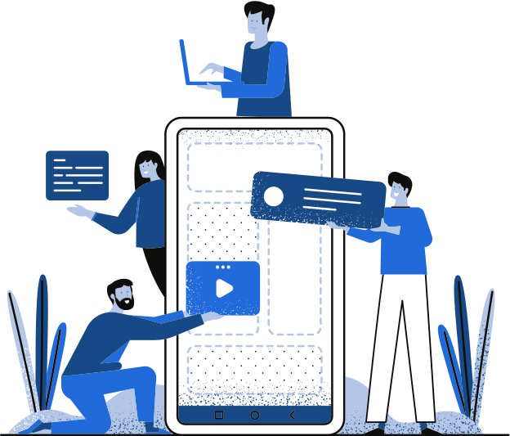
THANK YOU!
THANK YOU!
Write a closing statement or call-to-action here.

Slide 39

HAPPY DESIGNING!
CREDITS
This presentation template is free for everyone to use thanks to the following:
SlidesCarnival for the presentation template
Pexels for the photos

Slide 40

GET IN TOUCH
Email
hello@reallygreatsite.com
Social Media
@reallygreatsite
Call us
123-456-7890

Slide 41


HAPPY DESIGNING!
FONTS IN THIS PRESENTATION
This presentation template uses the following free fonts:
Titles: Poppins Medium
Headers: Bitter
Body Copy: Bitter
You can find these fonts online too.

Slide 42


Add a main point
Add a main point
Add a main point
Add a main point
ADD A TIMELINE PAGE
Add a main point

Slide 43




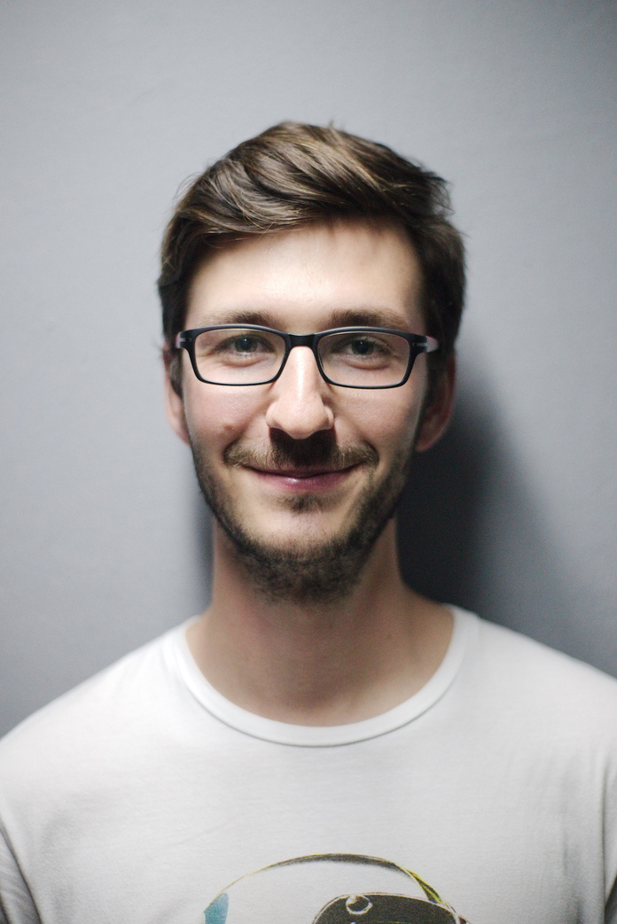


ADD A CHART PAGE
Name
Job Title
Name
Job Title
Name
Job Title
Name
Job Title
Name
Job Title
Name
Job Title
Name
Job Title

Slide 44
50
40
30
WRITE YOUR TOPIC OR IDEA
20
10
Elaborate on what you want to discuss.
0
Item 1
Item 2
Item 3
Item 4
Item 5

Slide 45




























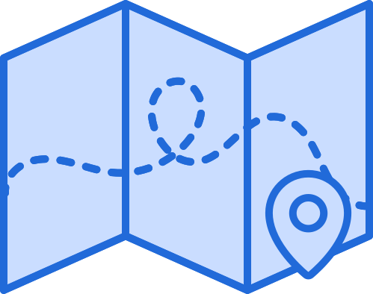










RESOURCE
PAGE
Use these design resources in your Canva Presentation. Happy designing!
Don't forget to delete this page before presenting.

Slide 46

RESOURCE
PAGE
Use these design resources in your Canva Presentation. Happy designing!
Don't forget to delete this page before presenting.

Slide 47

FREE TEMPLATES FOR ALL YOUR PRESENTATION NEEDS
For PowerPoint, Google Slides,
and Canva
100% free for personal or commercial use
Ready to use, professional,
and customizable
Blow your audience away with attractive visuals

